Slide 1
Presentation on E-Commerce(Online Shopping)

Slide 2
What is E-Commerce
Commonly known as Online Market Place
It Consist of buying and selling goods and services over an electronic systems such as the internet and other computer networks.

Slide 3
Project Overview
Our system is an e-commerce website where users can browse and buy products
Users can add products to the cart and checkout by entering their name, email, and address
Cart functionality is handled using browser Local Storage
A separate Admin Panel allows product management (Add, Edit, Delete)
Admin login is required to access the admin panel secured with admin id and password
Orders and product information are securely stored in the database

Slide 4
Features
Products List
Product Details Page
Product Browsing
Shopping Cart
Checkout
Admin Login
Admin Panel

Slide 5
Technologies Used
Frontend:
HTML
CSS
JavaScript
Backend:
Java + Spring Boot
DataBase:
MySQL

Slide 6
Business Process Model
Start
Product List
Customer
Add to Cart
Check Out
End
Admin
Admin Login
Add/Edit/Delete Products

Slide 7
Future Enhancements
Order History Tracking for users to view past purchases
Invoice Generation after successful checkout
Online Payment Integration (Razorpay, Stripe, UPI)
Email Notifications for order confirmations
Admin Dashboard Analytics (sales reports, top-selling items)

Slide 8
Graphical User Interface(GUI)

Slide 9
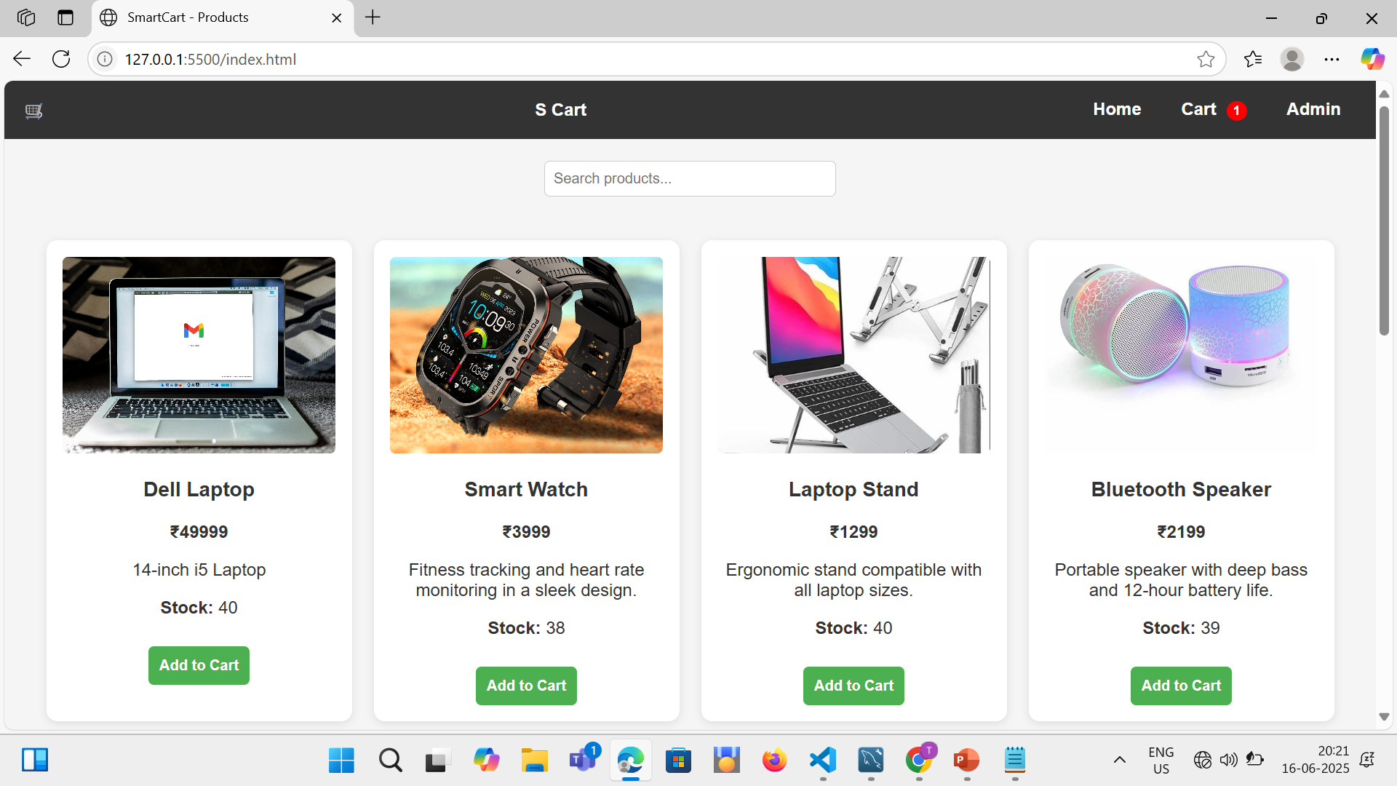
Home Page

Slide 10
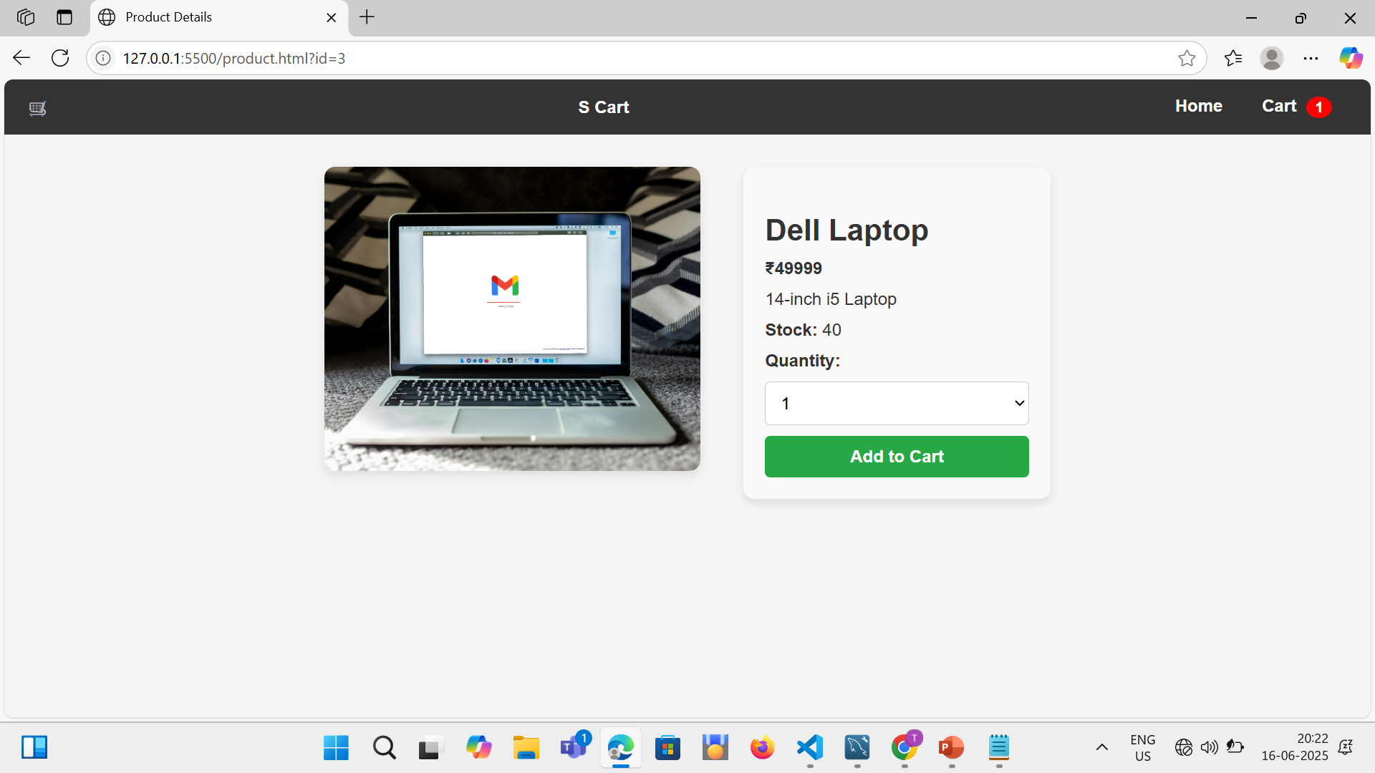
Single Product Page

Slide 11
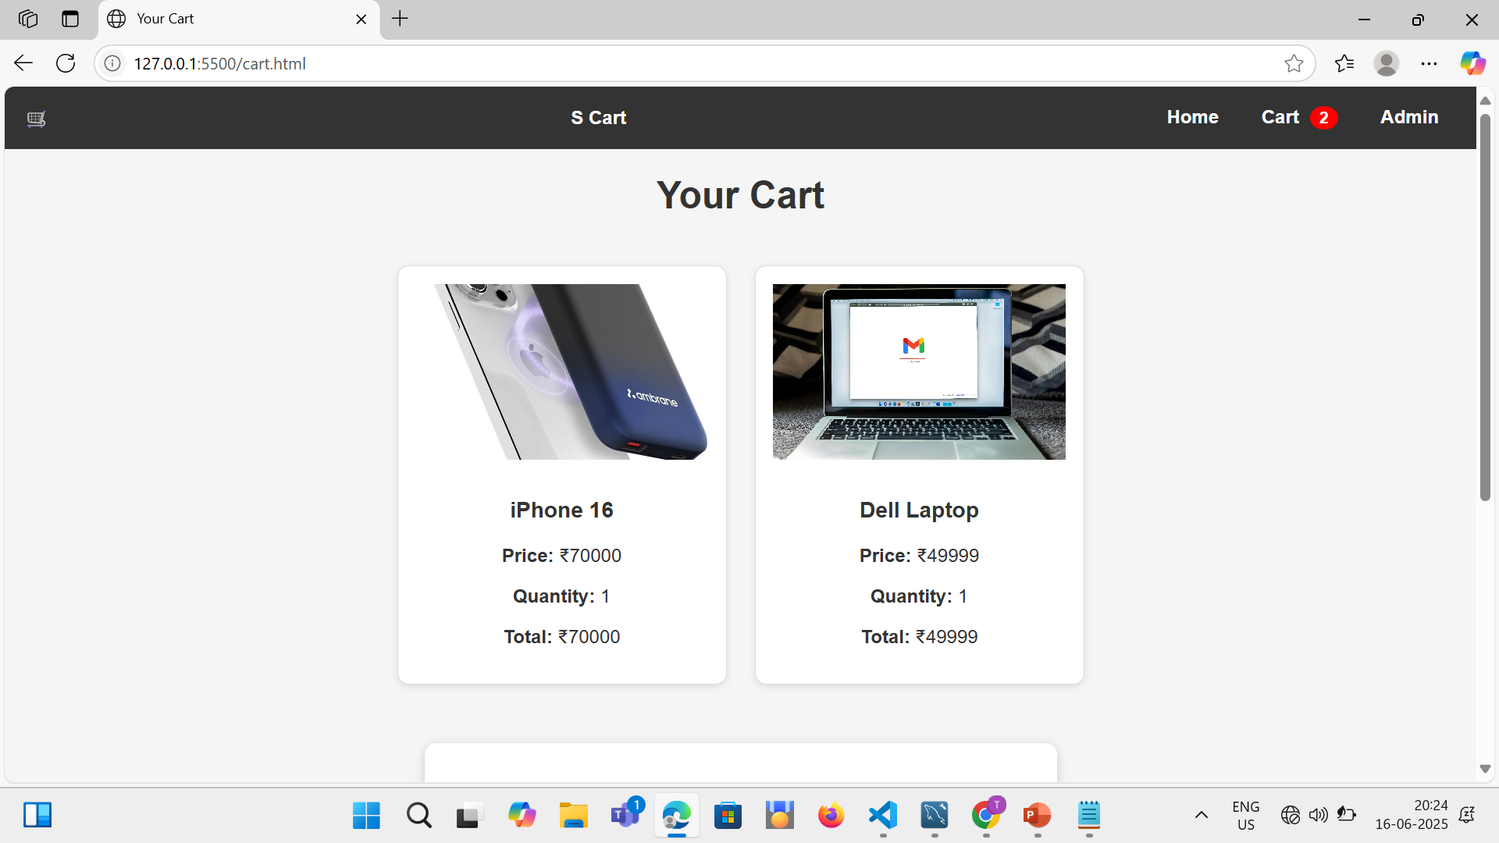
Cart & Checkout Page

Slide 12
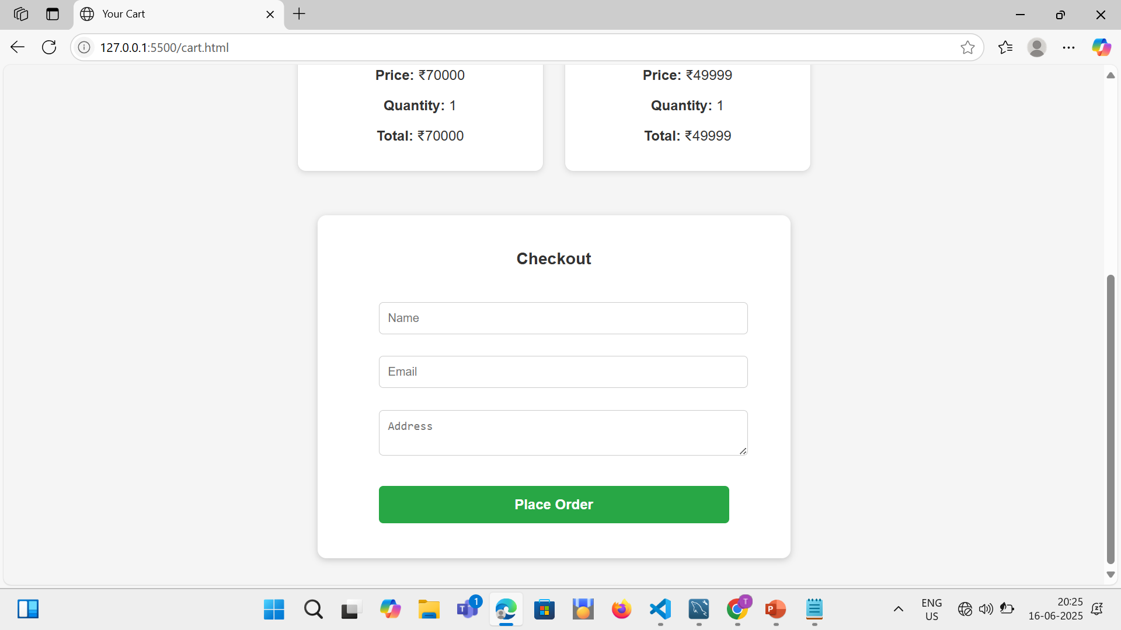

Slide 13
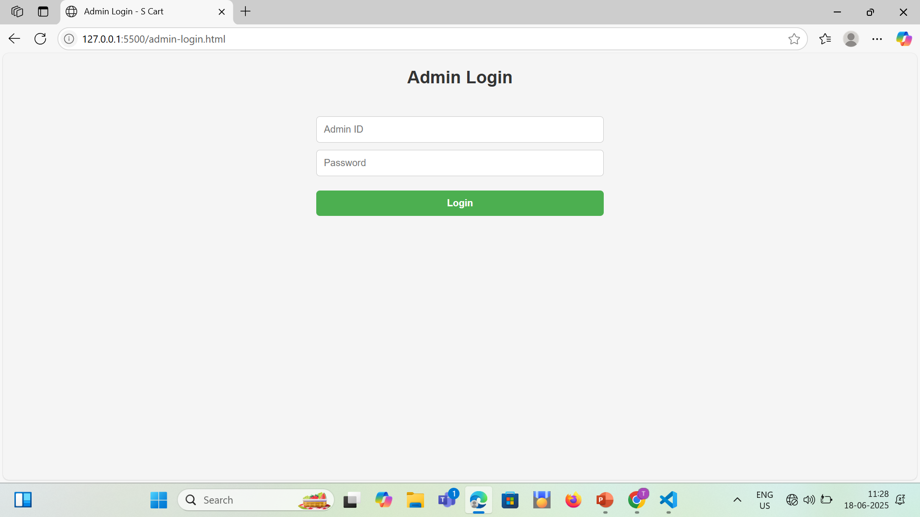
Admin Login Page

Slide 14
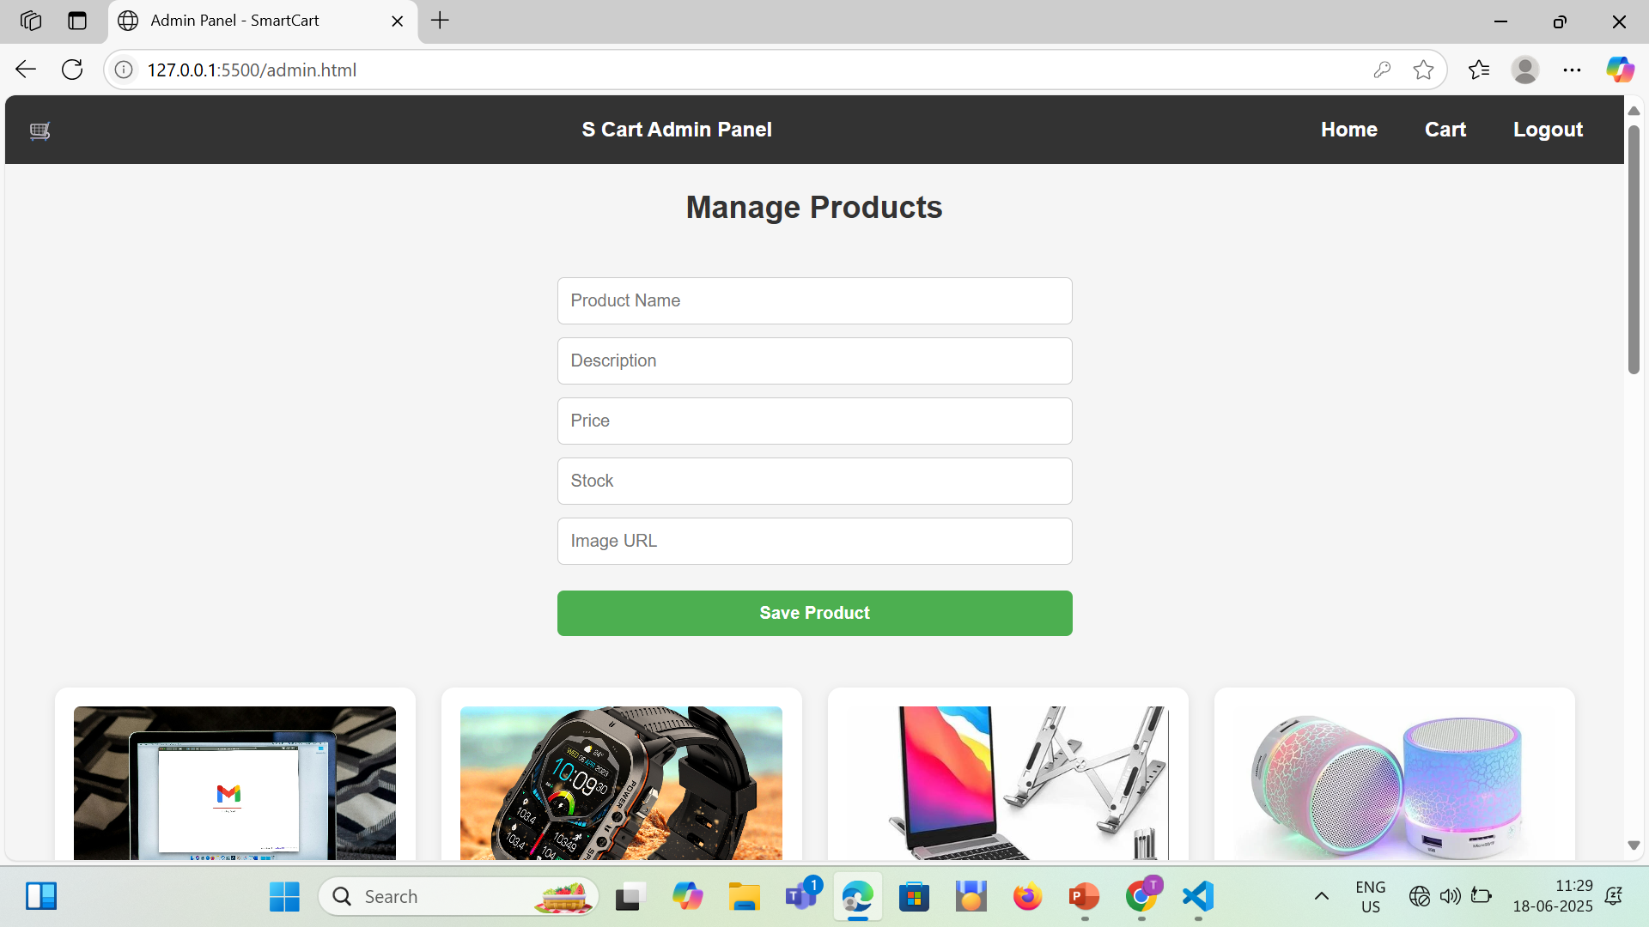
Admin Panel Page

Slide 15
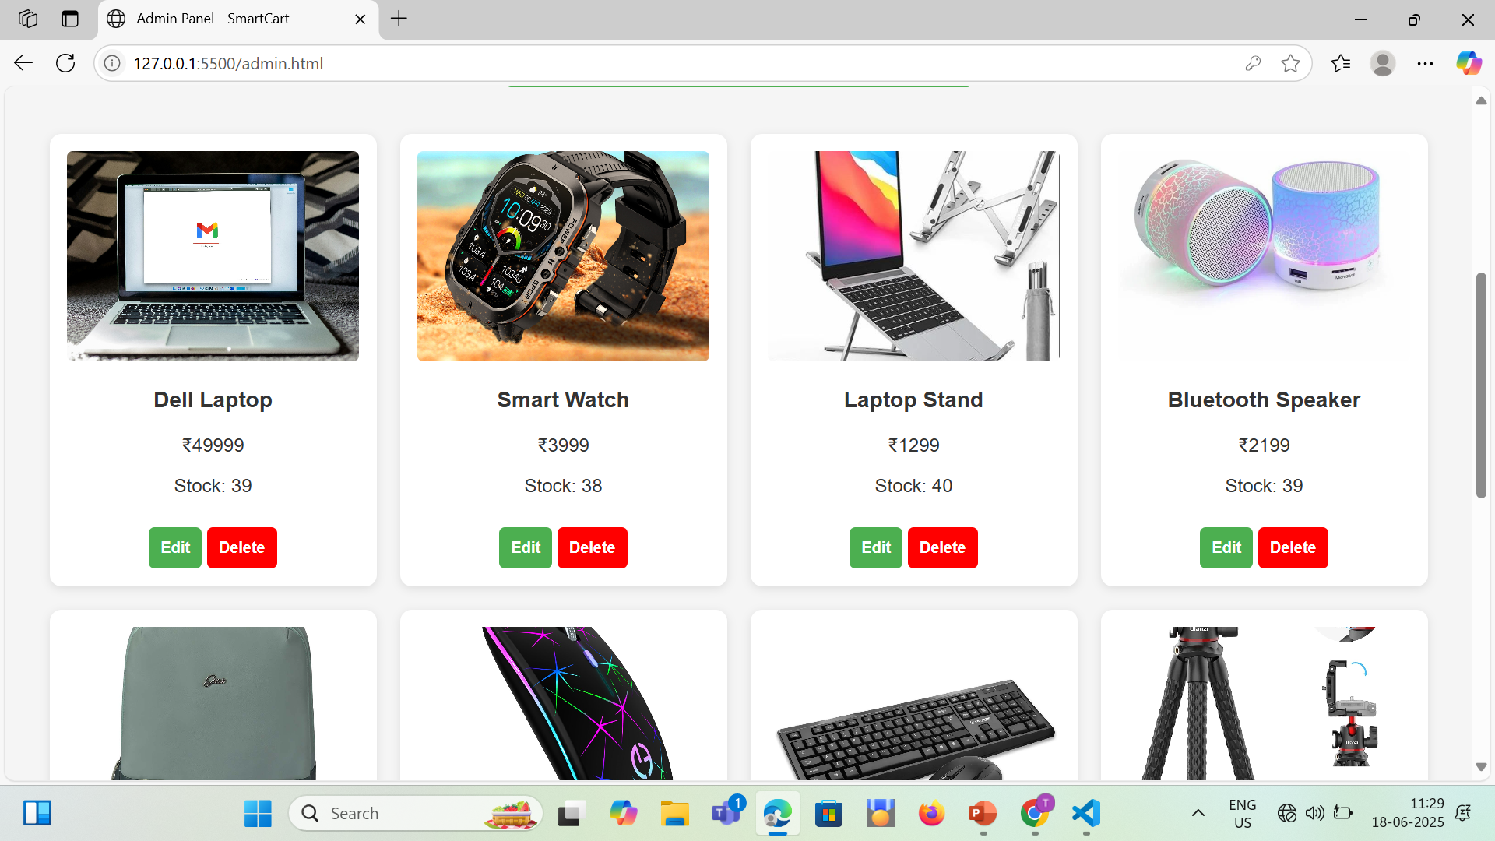

Slide 16
Thank You

